Slide 1






Musgrave Hackathon
Use Case - SuperValu Recipe/Shopbot
Team – DNA.AI
Satyajit Senapati
satyajit.senapati@infosys.com
Somnath Dutta
somnath.dutta@infosys.com
Dinesh Yadav
dinesh.kumaryadav@infosys.com
Nishant Malik
nishant.malik@infosys.com

Slide 2
High Level Brief on Solution & Features Considered
IMAGE RECOGNITION
INTEGRATION WITH BACKEND DATABASE
CUSTOMIZED RECIPE SUGGESTIONS
REAL-TIME SHOPING KART TRACKING
INTERACTIVE WIDGETS AS PER USER PREFERENCES
DELIVERY ITEM DATE
The solution approach is to build a user-friendly interactive bot which can be easily integrated with the existing Supervalu website, It contains various features including but not limited to generation of recipes based on items in your shopping cart or just by uploading an image of the food items at home.
Over the top it has valuable features including customization of cart based on diet preferences as well as calorie calculations of the cart along with delivery schedule time preferences as per the customer requirements.

Slide 3
DEMO –
SuperValu Bot

Slide 4
Benefits / Features :
Type | Use Case | Status
In Scope | Customers can interface with the shop bot in natural language and have a friendly efficient experience. | Completed
In Scope | Customers to enter their meal plan for the week and have a shopping cart populated with all of the items they will require. | Completed
In Scope | Customers can take a photo of the products they already have (e.g. in their fridge) and have a meal plan created for them for the week given their circumstances (e.g. family of 5) | Completed
In Scope | Customers can choose their shopping preferences across a range of dimensions such as cost (low/med/high), conditions (lactose intolerant, coeliac etc.), goals (weight loss) and the shop bot should take this information into consideration when developing the meal plan | Completed
In Scope | Customers will be advised how soon delivery can take place (e.g. Monday afternoon, need to make dinner, food can be delivered in next couple of hours). | Completed
Added Features | User Friendly Interactive Widgets | Completed
Added Features | Recommendations based on Cart | Completed
Added Features | Add missing items directly to Cart | Completed
Added Features | Calorie Tracking | Completed
Added Features | Bot Boundaries – Guardrails on Bot Response | Completed

Slide 5




Personas and Use Cases
Robbie
On a goal to lose weight ,
Needs to track calories
Maeve
Working Professional supporting a family of 5
Finn
Specific Diet preferences,
Allergic to Peanuts, Gluten
Liam
Working Professional, Lazy in Ordering always in hurry.
•Need to suggest food recipes less than 300 calories per meal?
•How can I create a weekly meal plan with meals under 300 calories each?
•What are some low-calorie options when eating out at a restaurant?
•Meal Plan for a week for a family of 5?
•Can you suggest budget-friendly, low-calorie meals for a family of five?
•How can I encourage my kids to eat more low-calorie, nutritious foods?
•Please suggest mild recipe without gluten and peanuts ?
•Can you suggest peanut-free and gluten-free dinner recipes under 400 calories per serving?
•What are some healthy, low-calorie snacks that are both gluten-free and peanut-free?
•Add all items to cart related to quick breakfast for this week?
•Can you recommend ready-to-eat low-calorie meals for busy days?
What are the best delivery services for low-calorie meal options?

Slide 6






Evolution: Possible Future State
Web-Based Bot
User Friendly Web Based Chat Bot
Upselling Opportunities
As more recommendations,
More
Voice Prompting
Integration with Voice, Both Including Prompt Questions as well as Responses.
AI-Driven Insight Generation: Beyond User Prompts
Generative AI can provide valuable insights without the user needing to provide specific prompts
Personalized Recommendations
Recommendations based on customer preferences
Inventory Management
Out of Stock Items , Real time checking the inventory
Easier Checkouts
Cart Manipulation by using the bot and checking out directly
Mobile App
Cross Platform Integrations

Slide 7
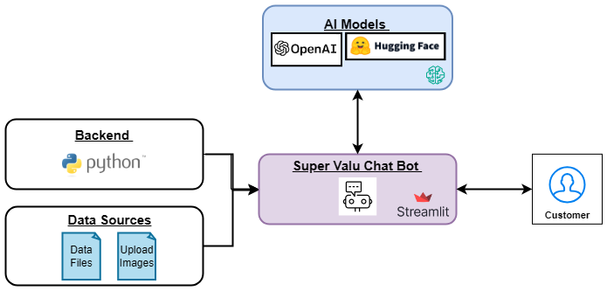

High Level Architecture Diagram

Slide 8









Architecture Diagram
SuperValu Shopbot
Prompt
Mongo DB
Open AI
Query
USER
Response
1- Meal Plan 2- Recipe
Any Recipe related query
Object detection
Local images
Proceed to Checkout

Slide 9
Tech Stack
Hugging face Model
OpenAI API
StreamLit GUI
MongoDB
Python
Local File System
This solution is leveraging the latest technology stack in the market, compromising of, AI/ML Models such as GPT-4o & Open Source Image Detection Models as well as user friendly UI using StreamLit and MongoDB.

Slide 10
Q&A

Slide 11
Thank You

